Slide 1

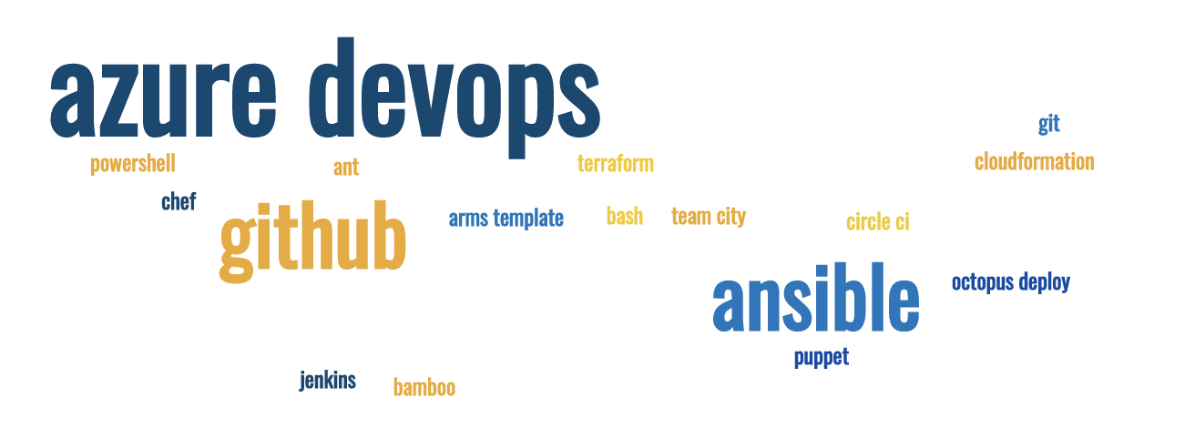
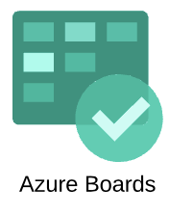
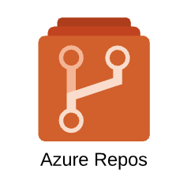


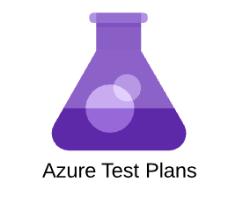
Azure DevOps part 4
Customization, Boards and Reports अपने ज़रूरत के हिसाब से अजूरे डेव ओप्स को अनुकूल करें प्रोजेक्ट की जानकारी के लिए रिपोर्ट बनाए
Sujit Singh

Slide 2
Agenda
Azure DevOps – Boards
Recap – Azure DevOps Boards
Backlog
Board
Sprint
Taskboard
Break and quiz …
Work item customization
Custom attributes
Reports

Slide 3
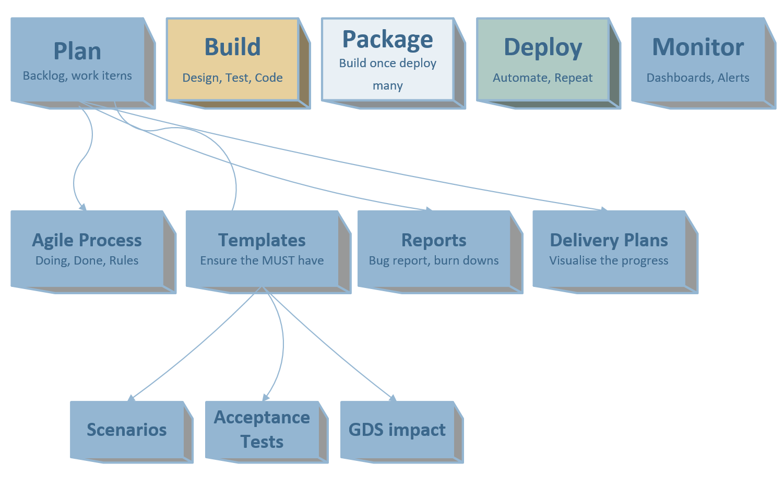
Azure DevOps – Boards (Plan)
Custom Rules

Slide 4
Azure Boards – recap
Free account
Azure Boards,
Azure Repos
Azure Pipeline
Azure Artifacts
Dashboards, Wiki etc

Slide 5
Azure Boards – Backlog
You can have multiple backlog in a single project
Each teams can have one backlog
Backlog is arranged by one or more areas
Backlog board is also referred as Kanban board*
Demo

Slide 6
Azure Boards – Sprint
Also known as iteration
Time bound iteration to focus on handful items
Comes with some ceremonies (aka Agile Ceremonies)
Allows capturing the learnings (Retrospective)
Build a continuous improvement mindset

Slide 7
Azure Boards – Taskboard
Very hand visual dashboard for daily meetings (stand ups)
Helps tracking the progress of sprint
Helps finding the productivity of a team
Also helps building further backlog as per new findings
Also used for identifying impediments or blockers to address

Slide 8
Break
Comments

Slide 9
Customization
Custom states
Custom Rules
Work item customization
Custom fields
Templating

Slide 10



New
Create User story
Add initial high-level requirement
Ready
Clear Description updated
Acceptance Criteria
Approved
Team agrees and understand implementation requirement
Estimated
Active
Tasks created
Unit testing
Persona and context provided
Implementation done, tasks closed
Documentation done
Resolved
Closed
Verified
Stakeholders informed
Product Owner
Business Analyst
Product Owner
Engineers
Engineers
Product Owner
New stories can be created by other team members (delegated by PO if agreed)
Approval can be done by Scrum master if PO agrees
Story can be closed by Scrum master if PO agrees

